Slide 1

Mini-POC Draft

Slide 2
What is ECU?
An electronic control unit (ECU) is a small device in a vehicle’s body that is responsible for controlling a specific function.
Today’s vehicles may contain 100 ECUs or more, controlling functions that range from the essential (such as engine and power steering control) to comfort (such as power windows, seats etc), to security and access (such as door locks and keyless entry).
Ecu take values from all the sensors and then decides what to do and give instruction to be carried out.

Slide 3
Types of Ecu
1.Engine Control Module
2.Brake Control Module
3.Body Control Module
4.Infotainment System Module
5.Passenger Safety Module

Slide 4
How Single ECU System Architecture Works
In single ECU , there is a central Body Control Unit that does all the work.
It is directly connected to various sensors, collects the required information from sensors and CAN network, does the processing and implements necessary action.
The fault can be easily located because of the centralized design of the architecture
How a Multiple ECUs Architecture System works
Multiple ECUs are tasked to manage different functions. However, each of them is interfaced with the main control unit, called the body control module.
These ECUs are connected to the respective sensors in order to fetch the required information.

Slide 5
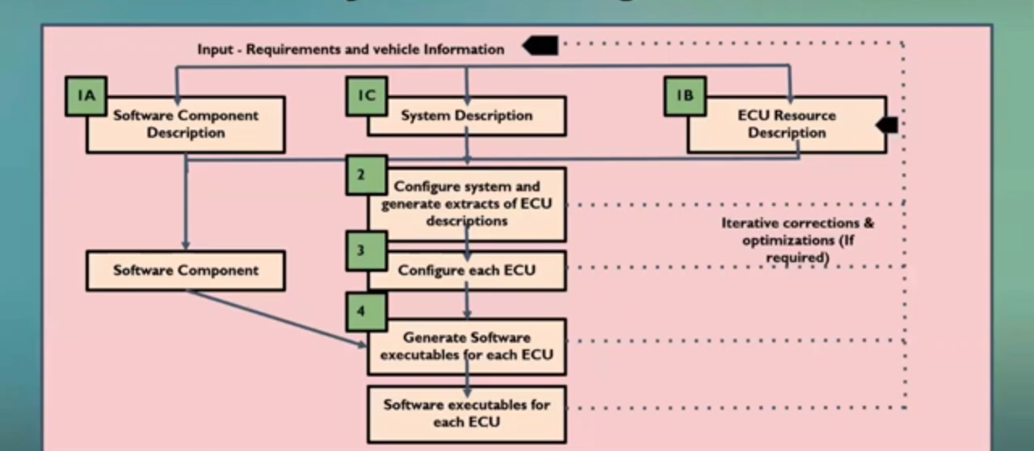
Sealt Belt Remainder system

Slide 6
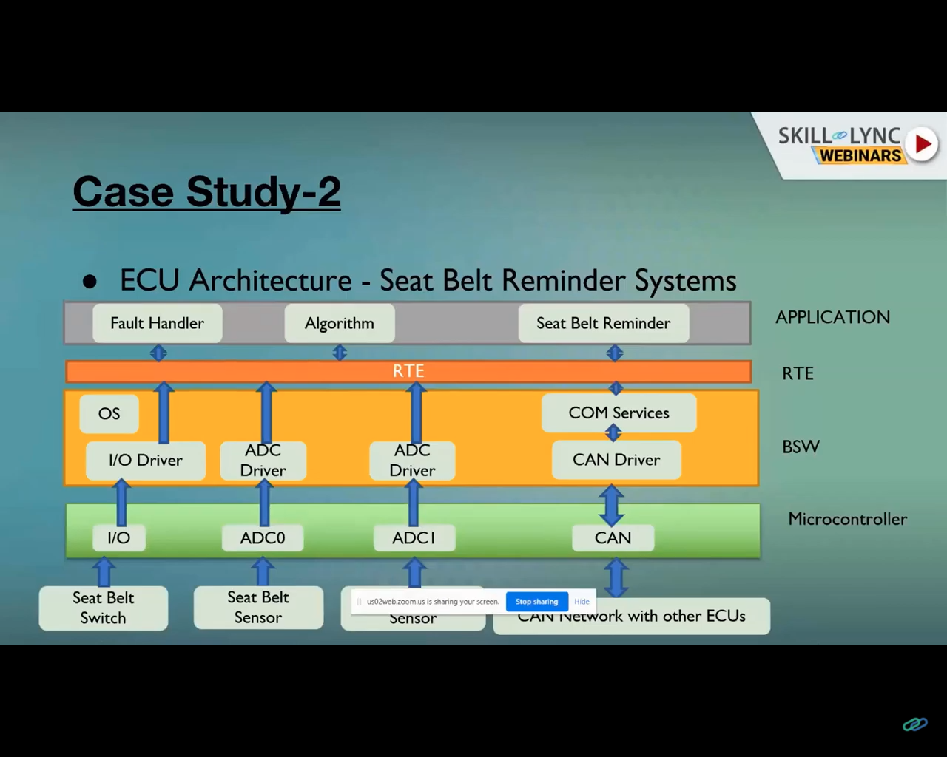

Slide 7
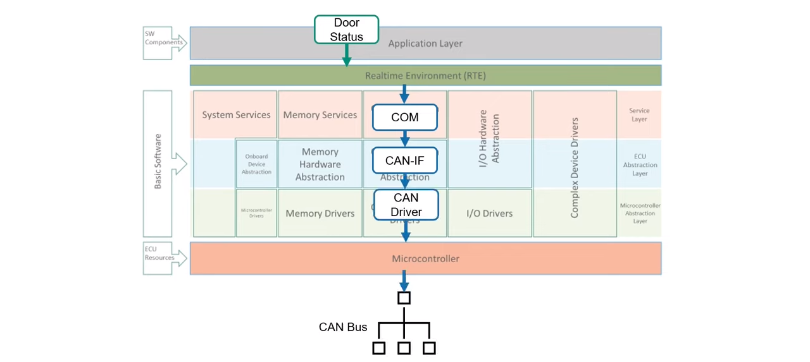
Door Status Software

Slide 8

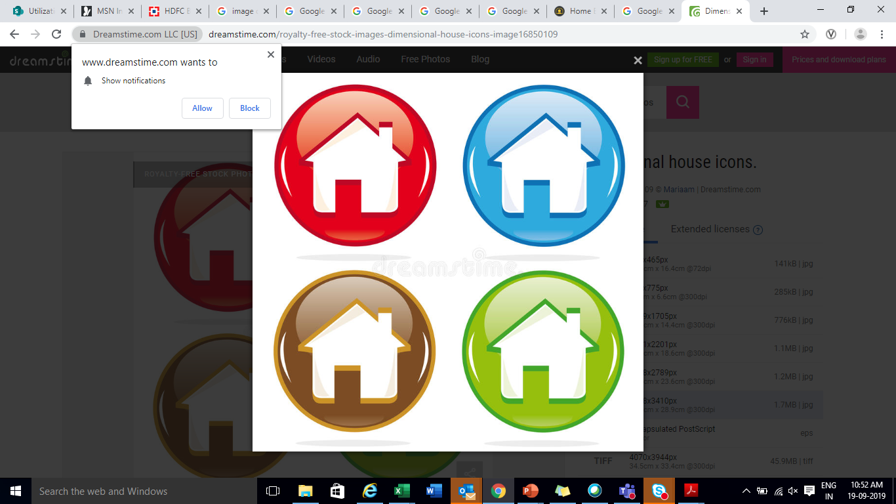
Thank You !

